Slide 1

GIT Overview

Slide 2
Agenda
Git Overview
Git Workflow
Commit Message Importance
Better Convention
Git Commit Better Practices
Tips & Tricks
Quiz

Slide 3

Git Overview
Git is a version-control system for tracking changes in computer files and coordinating work on those files among multiple people.
Git helps you keep track of the changes you make to your code. It is basically the history tab for your code editor.
If at any point while coding you hit a fatal error and don’t know what’s causing it you can always revert back to the stable state. So it is very helpful for debugging.

Slide 4
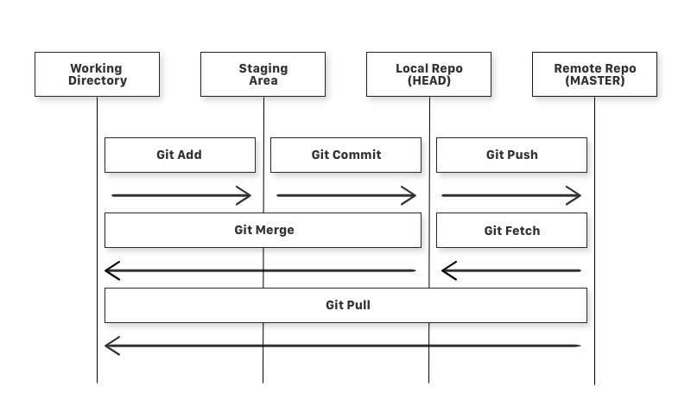
Git Workflow

Slide 5
Commit Message Importance
A well-organized commit message history leads to more readable messages that are easy to follow when looking through the project history.
Importance
Bring up transparency by communicate the nature of changes in your codebase to a variety of audience: existing teammates, future contributors, and sometimes the public and other stakeholders.
Peer Code Review requires a well-formatted Git commit message convention to communicate context about changes to fellow developers.
Structured commit history is required to understand which notable changes have been made between each release (or version) of the project.

Slide 6
Commit Message Convention
type(scope) : subject
1. Type of Commit
feat: The new feature being added to a particular application
fix: A bug fix
style: Feature and updates related to styling
refactor: Refactoring a specific section of the codebase
test: Everything related to testing
docs: Everything related to documentation
chore: Regular code maintenance

Slide 7
2. Scope of Commit
A scope must consist of a epic name or JIRA number under which we are describing our
change.
feat(WCR-XXXX) feat(epicName) fix(WCR-XXXX)
3. Subject
Limit the subject line to 50 characters
Your commit message should not contain any whitespace or punctuations
Do not end the subject line with a period
feat(WCR-XXXX): add model selection validations
[WCR-XXXX]: add model selection validations

Slide 8
Git Commit Best Practices
Make Small, Single-Purpose Commits
Commit Early & Often
Test Your Code Before You Commit
Agree on A Workflow

Slide 9
Tips and Tricks

Slide 10
Useful Commands
Cherry picking commits
git cherry-pick <commit-id(s)>
Cherry picking commits without committing the changes
git cherry-pick <commit-id(s)> -n
Restoring staged files
git restore --staged <filename>
Popping your stashed changes
git stash pop <index>

Slide 11
BitBucket Features
Navigating from one line of code to the associated PR
Identifying the developer who made a particular change
BitBucket – JIRA integration

Slide 12
Merge Conflicts
Options:-
Keep your change and ignore the incoming change completely
Keep the incoming change and discard your own change
Keep both the changes
Keep a combination of your and the incoming change
Can easily be resolved manually
Marking conflict resolution after resolving it manually: git add <filename>

Slide 13
Quiz

Slide 14
Thanks

